Slide 1
Section 1.5b Inverse of Quadratic Functions
i) Concept of Inverse functions
ii) Domain and Range of the inverse of a QF
iii) Graphing the inverse of a QF
© Copyright all rights reserved to Homework depot: www.BCMath.ca

Slide 2
Inverse Functions
The inverse of a function will switch the X and Y variables and then isolate the Y variable afterwards
ie: Given the function, find its inverse:
Switch the two variables
Isolate the Y-variable
The inverse function is:
Graphically, the inverse of a function is a reflection over the line y=x
Switch the “x” and “y” coordinates to generate new points for the inverse graph
© Copyright all rights reserved to Homework depot: www.BCMath.ca

Slide 3
Ex: Given the graph of , Graph the inverse function
Suppose we have a TOV for the original function
New coordinates can be found by switching the X & Y coordinates
y
5
4
3
2
1
x
-4
-3
-2
-1
0
1
2
3
4
5
6
7
-1
-2
-3
-4
-5
© Copyright all rights reserved to Homework depot: www.BCMath.ca

Slide 4
Practice: Find the inverse of the following function and graph it.
y
5
4
3
2
1
x
-4
-3
-2
-1
0
1
2
3
4
5
6
7
-1
-2
-3
-4
-5
© Copyright all rights reserved to Homework depot: www.BCMath.ca

Slide 5
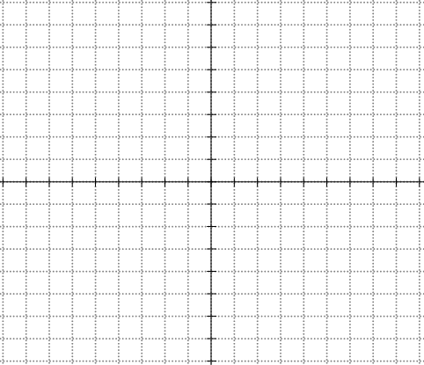
The Inverse of a Quadratic Function
The inverse of a QF is not a function because it does not pass the vertical line test
So we must split the QF to two separate domains with the axis of symmetry. When the QF is broken into 2 parts, the inverse of each part will be a function
The inverse of the right side
is on top
The inverse of the left side
is on bottom
Each graph is split along the axis of symmetry
© Copyright all rights reserved to Homework depot: www.BCMath.ca

Slide 6
Find the inverse of the following function:
Switch “x” and “y”
Isolate “y”
When you square root a value, you get both a positive and negative answer
represents the
top of the inverse function
represents the
bottom of the inverse function
© Copyright all rights reserved to Homework depot: www.BCMath.ca

Slide 7
Domain & Range of the Inverse function:
Since we switch the x and y variables for the inverse, the domain of f(x) becomes the range of the inverse
Make sure you know which side of the domain that you are taking the inverse of
Likewise, the range of f(x) becomes the domain of the inverse
© Copyright all rights reserved to Homework depot: www.BCMath.ca

Slide 8
Ex: Find the domain and Range of the inverse function
We’re taking the inverse of the right side of the parabola
The graph opens up with a minimum value
© Copyright all rights reserved to Homework depot: www.BCMath.ca

Slide 9
Practice: Find the inverse function and its domain and range:
Switch “x” and “y”
Isolate the “y” variable
Take the negative square root because the domain is on the left side
Use the domain and range of f(x) to find the domain and range of the inverse
© Copyright all rights reserved to Homework depot: www.BCMath.ca

Slide 10
Given the function, find each of the following values
y
5
x
-5
0
5
-5
© Copyright all rights reserved to Homework depot: www.BCMath.ca

Slide 11
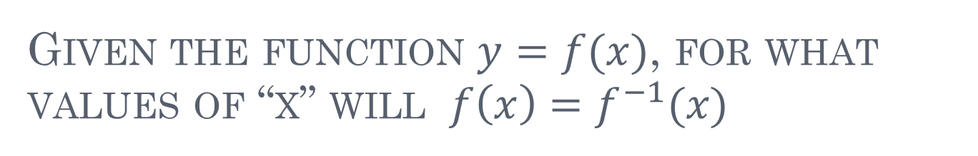
Given the function $y=f(x)$, for what values of “x” will $f\left(x\right)=f^{−1}(x)$

Slide 12
Homework:
Assignment 1.5
© Copyright all rights reserved to Homework depot: www.BCMath.ca

